Slide 1
Three Awesome Things From Learning How to Tidy “Real” Excel Dirty Data in R

Slide 2

Awesome Thing #1
No longer needing to Spend 40 Hours Manually Taking Excel Dirty Data and Making it Clean

Slide 3
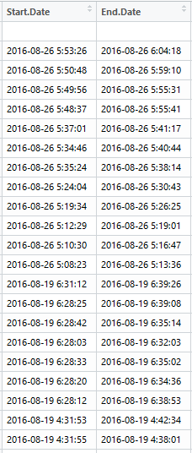

Awesome Thing #2
Can Keep Extra Columns, Comments, and Such Without it Really Getting in the Way

Slide 4
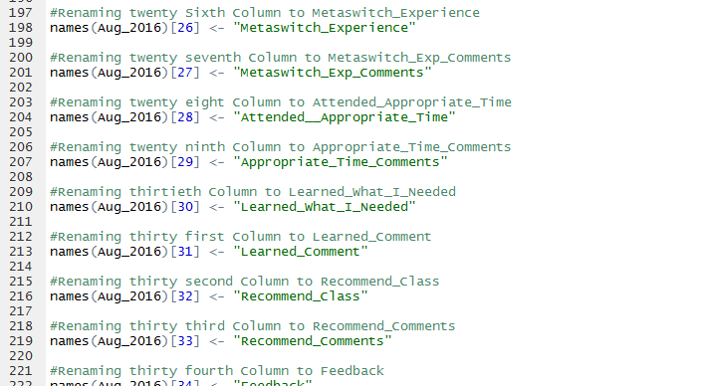
Awesome Thing #3
While Working With the R Script the Data is Not Actually Permanently Saved so Easy to Reverse What
I was Doing If Needed

Slide 5
Thank you

